Slide 1



Python Programming
Lecture 21: Introduction to FastAPI

Slide 2


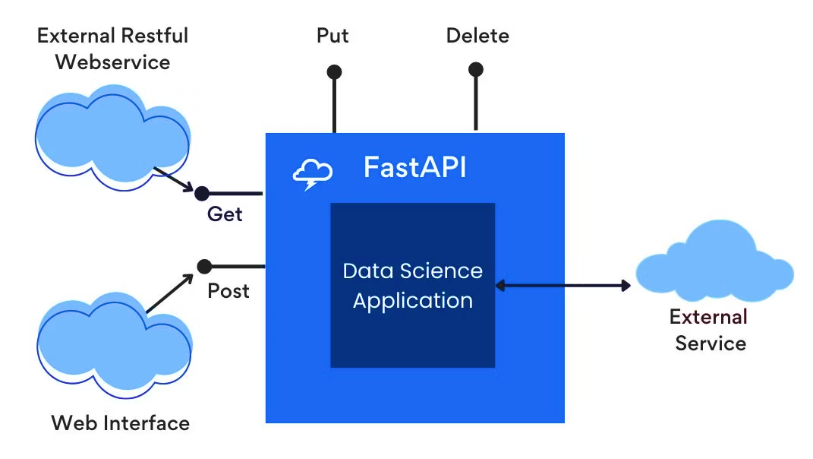




Introduction to FastAPI
Core Functionality
Key Feature
FastAPI is a modern, high-performance web framework designed specifically for building APIs using Python.
It leverages Python 3.6+ features such as type hints to provide automatic data validation and documentation.
Benefit
Application
FastAPI aims to make API development fast, easy, and less error-prone.
Many modern applications rely on APIs to connect different services and platforms.
Industry Standard
Empowerment
FastAPI is widely adopted in industry for its speed and simplicity.
Learning FastAPI will empower you to turn your Python projects or AI models into accessible web services.

Slide 3
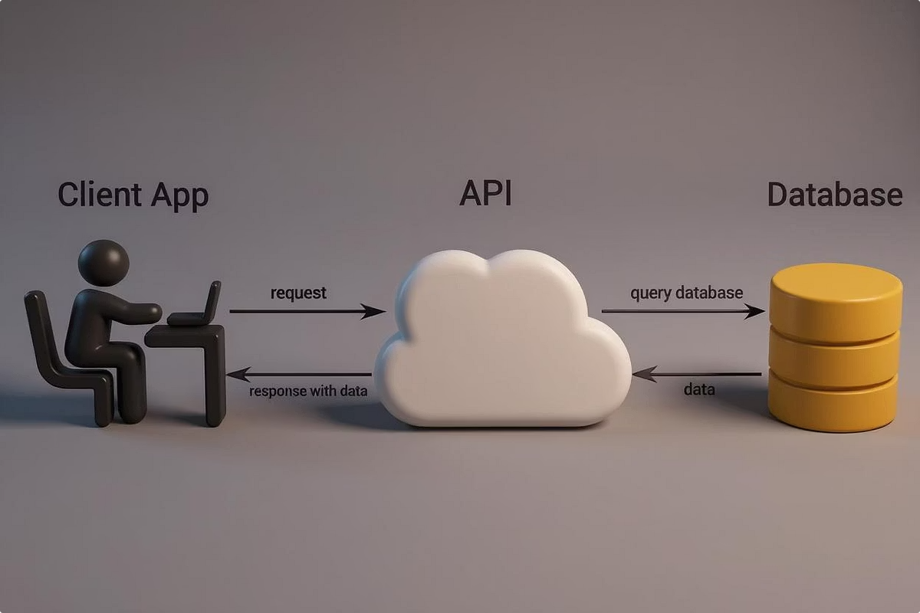
Understanding APIs
What is an API?
An API (Application Programming Interface) is a set of rules and tools that allow different software applications to communicate.
It defines how requests for data or services are made and how responses are returned.
APIs are like messengers that deliver your request to a system and bring the response back.
Why Are APIs Important?
APIs make software modular and interoperable.
They enable mobile apps, web apps, and other programs to use backend services without knowing their internal details.
APIs are essential for creating scalable and maintainable software.

Slide 4

FastAPI — The Waiter Analogy
Chef and Waiter Analogy
Imagine your Python code or AI model is the "chef" who prepares dishes (processes data).
Users want to interact with this chef but cannot directly enter the kitchen.
FastAPI acts as the "waiter" — it takes user requests, forwards them to the chef, and returns the prepared results back to the users.
How This Works
The user sends a request (e.g., a URL visit or data submission).
FastAPI receives the request, calls your Python function, and waits for the result.
Once ready, FastAPI sends the result as a response in a web-friendly format like JSON.

Slide 5
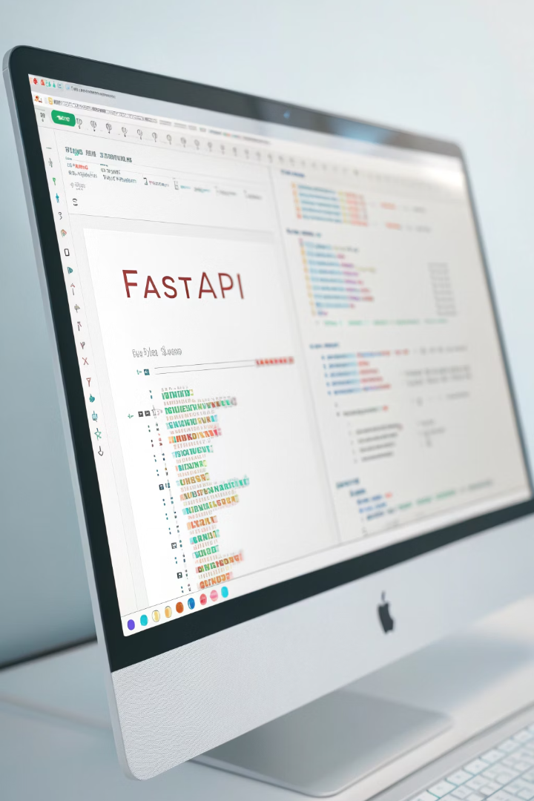


Setting Up Your Environment
Installing FastAPI
To get started, you need to install FastAPI in your Python environment.
Run the command: pip install fastapi
This downloads the FastAPI package and its dependencies.
Installing Uvicorn
Uvicorn is a fast, lightweight web server that runs your FastAPI app.
Install it using: pip install uvicorn
It serves your API locally during development and can be used in production environments.

Slide 6
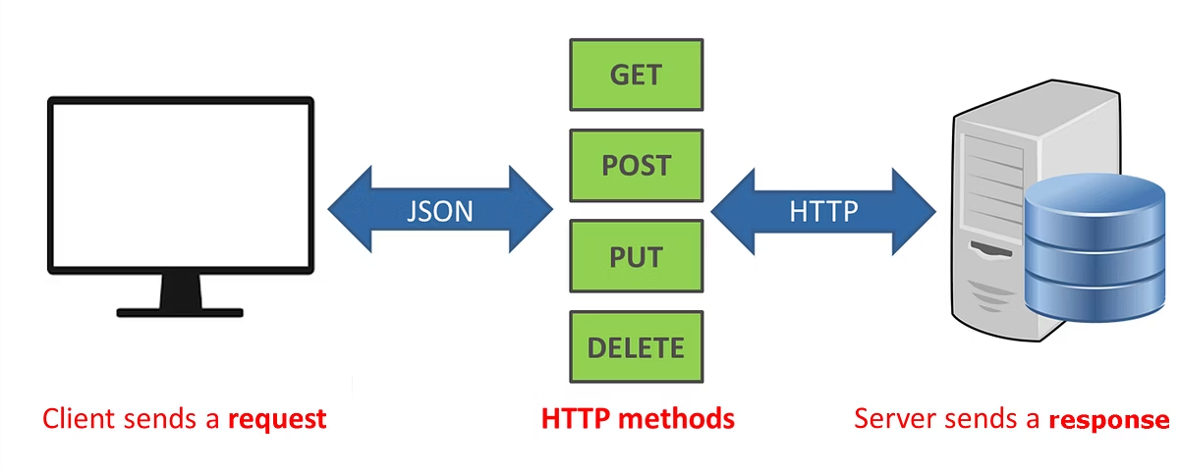
Creating Your First FastAPI Application
Importing FastAPI
You start by importing the FastAPI class:
from fastapi import FastAPI
This class provides the main API-building tools.
Creating the App Instance
Next, create an instance of FastAPI:
app = FastAPI( title="My First API", description="A simple API using FastAPI", version="1.0.0" )
These metadata values help generate user-friendly documentation automatically.

Slide 7



Defining Routes and Endpoints
What Are Routes?
What Are Endpoints?
Example
Routes are URL patterns where your API listens for requests.
Endpoints are the actual functions in your code that handle requests sent to routes.
The root endpoint / might return a welcome message.
For example, / is the root route (home page).
The /hello/{name} endpoint takes a name as input and returns a personalized greeting.
They contain the logic to process input and return responses.
/hello/{name} is a route that accepts a variable part called name.

Slide 8
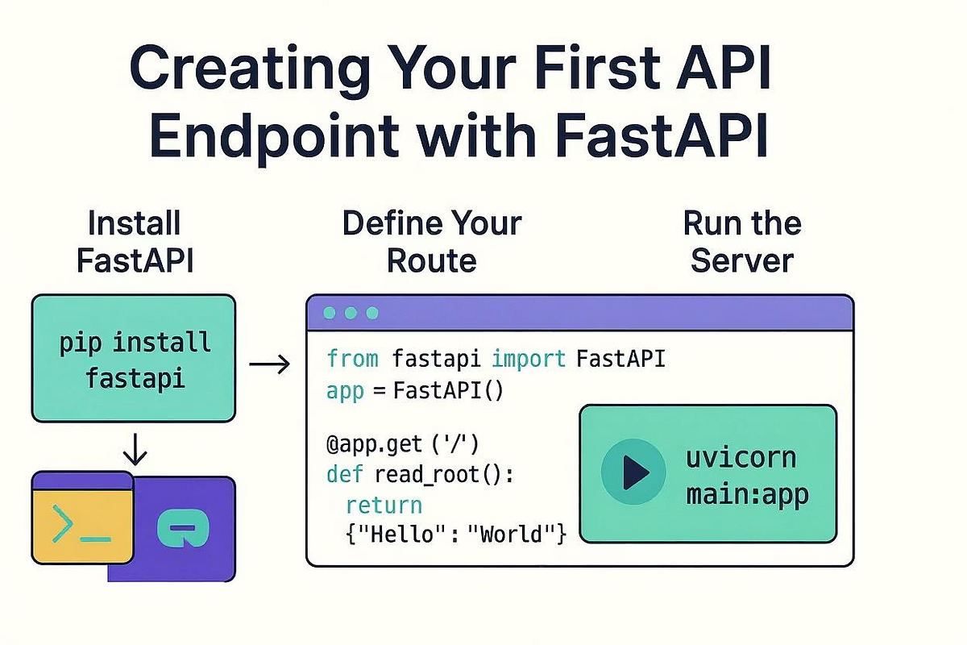
Writing Your First Endpoint
Root Endpoint (/)
Use a decorator to specify this endpoint listens to HTTP GET requests on /:
@app.get("/")
def read_root():
return {"message": "Hello World! Welcome to FastAPI"}
The function returns a dictionary which FastAPI converts to JSON for the client.
How It Works
When a user opens the base URL in their browser, this function is called.
The returned message is displayed as a JSON response.

Slide 9
Path Parameters in Endpoints
Using Dynamic Paths
Function Input
You can create URLs that accept variables:
The function takes the path parameter as an input argument.
@app.get("/hello/{name}")
def read_item(name: str):
You specify the type (e.g., str) to let FastAPI validate and convert inputs automatically.
return {"message": f"Hello, {name}!"}
The part inside {} is a path parameter.

Slide 10
Connecting Endpoints to Functions
Decorators Link Routes
Execution Flow
The @app.get() decorator tells FastAPI which function corresponds to which route and HTTP method.
When the route is called via HTTP GET, FastAPI executes the linked function.
The function's return value becomes the HTTP response body.

Slide 11


Running Your API Server
Using Uvicorn
Why Reload?
To run your API locally, execute:
The --reload flag watches your code for changes.
uvicorn filename:app --reload
It automatically restarts the server so you don't need to stop and start manually during development.
Replace filename with your Python file name (without .py).
app is the FastAPI instance name.

Slide 12
Accessing Your API Locally
Open a Browser
Testing Endpoints
Visit http://localhost:8000 to see the root message.
You can manually change the URL to test different inputs.
Visit http://localhost:8000/hello/YourName to test personalized greetings.
This helps verify your API works as expected.

Slide 13
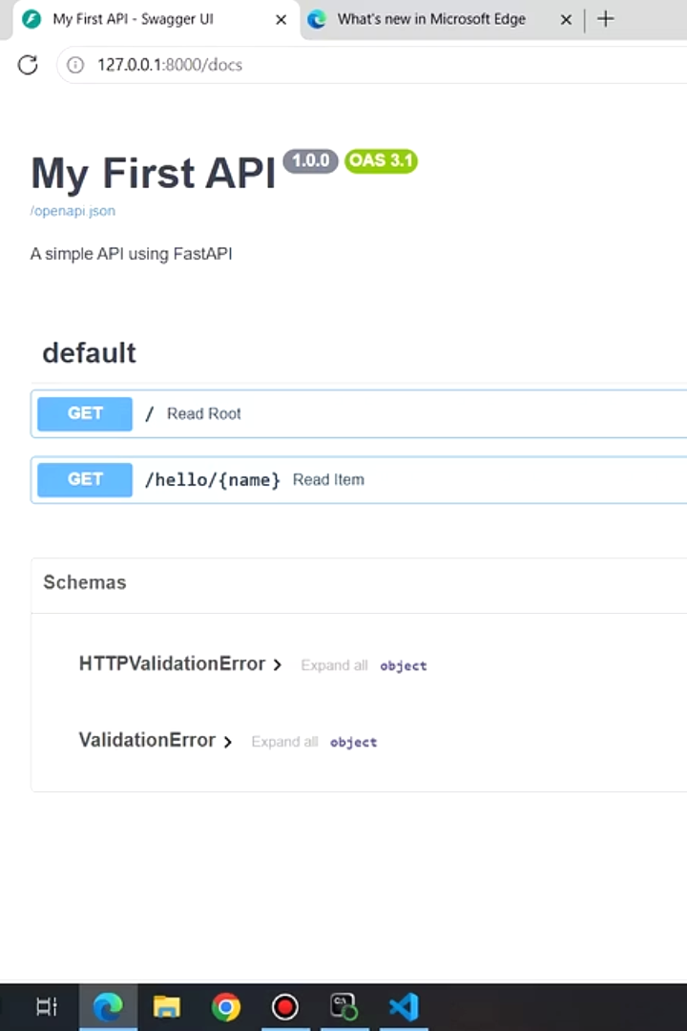


Automatic API Documentation
What Is Swagger UI?
FastAPI generates interactive API docs accessible at:
http://localhost:8000/docs
Swagger UI lets you see all endpoints, their inputs, and try them out interactively.
What Is ReDoc?
Another documentation interface provided by FastAPI.
Accessible at:
http://localhost:8000/redoc
Offers a clean and detailed view of your API.

Slide 14

Benefits of Automatic Docs
Saves Time
Easier Collaboration
No need to write separate documentation manually.
Other developers can quickly understand your API.
Docs update automatically as you change your API.
They can test endpoints directly from the documentation page.
Interactive Testing
You can send sample requests and see responses without additional tools.

Slide 15
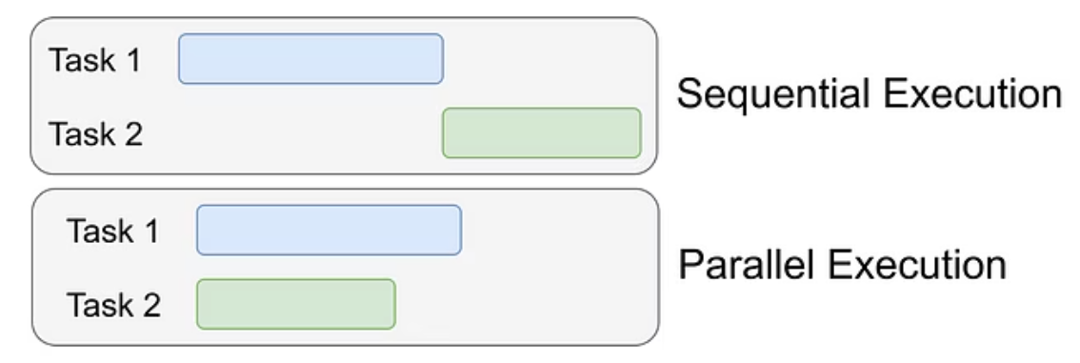
Handling Multiple Requests
Why Is This Important?
How FastAPI Manages This
Real-world APIs serve many users at once.
FastAPI is based on ASGI (Asynchronous Server Gateway Interface).
Your API must respond quickly without blocking others.
Supports async programming to handle many requests concurrently.
This improves performance and scalability.

Slide 16
Stopping and Restarting the Server
How to Stop?
Restarting
In your terminal, press Ctrl + C to stop the running server.
Simply run the Uvicorn command again to restart the server.
The server must be active to respond to API requests.

Slide 17



FastAPI Project Structure
Organizing Code
As projects grow, organize code by:
Separating routes (endpoints) into different files.
Using models for data validation.
Keeping utility functions separate.
Using Comments
Comment your code clearly.
Explain what each endpoint and function does.
This helps readability and future maintenance.

Slide 18

Debugging Tips
Use --reload
Read Terminal Logs
It helps catch errors quickly by applying code changes instantly.
Pay attention to errors and warnings in your terminal.
Logs provide clues to fix bugs.
Test Frequently
Use Swagger UI or tools like Postman to verify API behavior regularly.

Slide 19




Security Best Practices
Never Expose Secrets
Use Environment Variables
Don't hardcode API keys, passwords, or tokens in your code files.
Store sensitive data in environment variables or .env files.
Load them at runtime to keep your secrets safe.
Control Access
Implement authentication (login, API keys, OAuth) as needed.
Restrict who can call your API endpoints.

Slide 20
Summary
What You Learned Today
FastAPI basics: installation and setup.
Defining routes and endpoints with decorators.
Running the app locally with Uvicorn.
Viewing and using automatic documentation.
Handling asynchronous requests efficiently.

Slide 21



Next Steps and Practice
Practice Ideas
Create new endpoints with query parameters.
Return different response types like lists or nested data.
Explore asynchronous endpoints (async def functions).
Upcoming Topics
Input validation using Pydantic models.
Handling POST requests and receiving JSON payloads.
Structuring larger FastAPI projects.
Building full-featured APIs for real-world apps.

